Slide 1

REDESIGNING A UNIVERSITY PORTAL FOR ENHANCED USER EXPERIENCE
Team ID:PT1394
Name: Ms. Puchha Bhavya(42614102)
Ms. J.Prerna(42614101)
Dept: CSE in specialisation with Cyber Security
Project Supervisor
Dr.R.Shalini
Assistant Professor
Department of CSE

Slide 2
Presentation Outline
Course Certificate
Introduction
Objectives
System Architecture / Ideation Map
Module Implementation
Application Snapshots
Results and Discussions
Conclusion & Future work
References

Slide 3
Introduction
Enhance the university portal’s usability, accessibility, and overall experience to meet the needs of students, faculty, and staff.
This will boost user satisfaction, engagement, and productivity.
Problem Statement :The current university portal presents challenges in usability and navigation, leading to a frustrating experience for students, faculty, and staff.
Objective: The objective is to create an intuitive, mobile-friendly platform that enhances user experience and reduces time spent on administrative tasks.

Slide 4
Objectives
The objective of the redesigning project is to create a modern, user-centric university portal that enhances the overall experience for all.
This includes the ease of navigation, optimizing for mobile use, integrating key services such as course management, announcements, and student services
Scope :The project will involve user research, redesigning the portal interface for improved navigation and mobile optimization ensuring accessibility and security compliance.
To achieve the objective of redesigning the university portal for an improved user experience:
1.User Research
2.Design & Prototyping
3.Accessibility & Security
4.Testing & Feedback
5.Training & Support

Slide 5
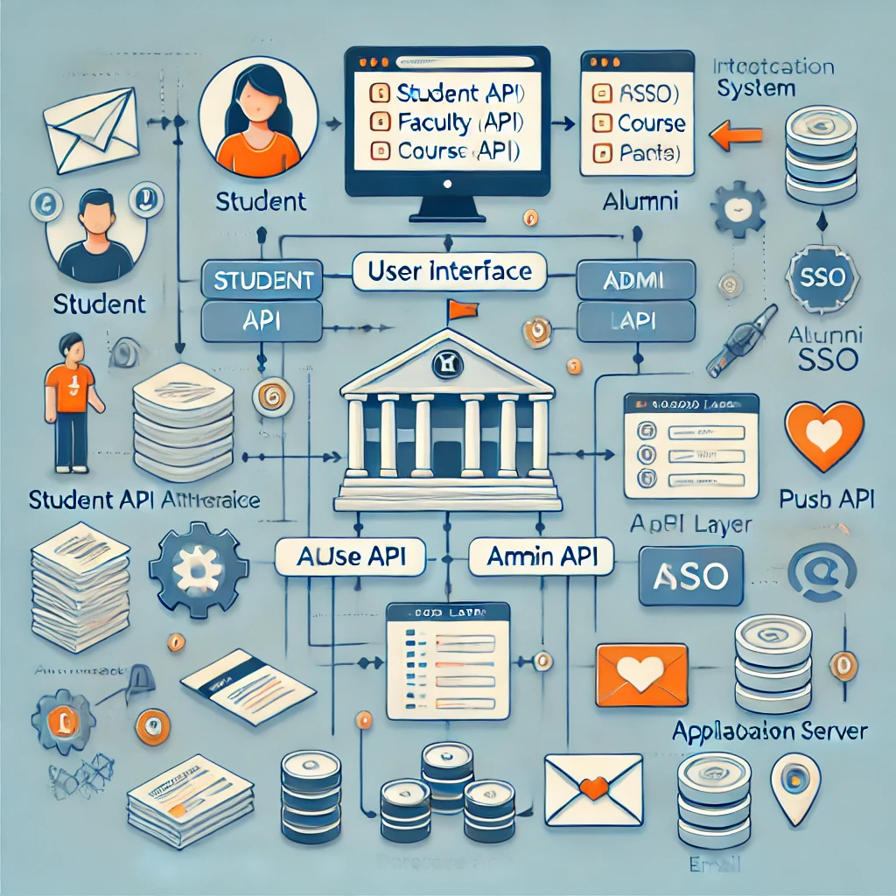
System Architecture / Ideation Map

Slide 6
Project Implementation
The project implementation for redesigning a university portal with a focus on user experience involves four key phases.
First, Research & Discovery gathers user insights through stakeholder interviews and surveys to identify pain points and needs.
Next, in the Information Architecture & Design phase, the new portal structure is outlined with wireframes, prototypes, and usability testing to ensure a smooth, intuitive interface.
Development follows, where the frontend and backend are built, APIs are integrated, and the system is optimized for performance and security.
Finally, Testing & QA ensures the portal is fully functional, secure, and meets all user and performance requirements.

Slide 7
Design Requirements
1.UserCentric Design:
Personalized Dashboards: Tailored views for students, faculty, and staff, showing relevant information like courses, deadlines, and announcements.
Easy Navigation: Intuitive menu and search functions for easy access to key resources (courses, grades, payments, etc.).
2. Functional Features:
Notifications System: Push notifications and email alerts for important updates like grades, deadlines, or class changes.
Integration with Student Information Systems (SIS): Seamless communication with backend systems to pull data on course registration, grades, schedules, and financials.
Single SignOn (SSO): Simplified login for all users via existing university credentials.

Slide 8
SOFTWARE REQUIREMENT TOOLS:
Design Tools: Figma for wireframing, prototyping, and highfidelity UI designs.
Frontend Development:
HTML5: Core technologies for structuring the web pages and ensuring responsiveness.
Backend Development:
Node.js: For building the backend, handling serverside logic, and integrating APIs.
MySQL: Databases to store user profiles, course information, grades, and other structured data.

Slide 9
Methodology
1. User Research:
Conduct surveys, interviews, and usability testing to understand student and faculty needs.
Analyze user behavior and pain points in the current portal.
2. Wireframing:
Create low-fidelity wireframes to map out the portal’s layout and structure.
Focus on content hierarchy and navigation flow.
3. Prototyping:
Develop high-fidelity prototypes in Figma with interactive elements for testing key features.
Ensure mobile responsive designs and role specific user interfaces.

Slide 10
4. Usability Testing:
Test prototypes with real users (students, faculty) to gather feedback on navigation, accessibility, and overall usability.
Make iterative improvements based on testing feedback.
5. Design System Creation:
Develop a consistent design system including reusable components, typography, and color schemes to maintain design cohesion.
6. Final Design Handoff:
Prepare the final Figma files with annotations for developers, ensuring clear communication of UI/UX standards and interaction details.

Slide 11
Sprint 0(planning)
Design and Development
Testing
Design prototype
Sprint review
Final launch
User research
Continuous integration /deployment

Slide 12
.
Define project goals, create a backlog of user stories, and establish the project roadmap.
Select and prioritize user stories for the sprint.
Define tasks and responsibilities.
Design UI/UX prototypes and develop frontend and backend features.
Integrate APIs and ensure mobile responsiveness.
Perform unit, integration, and user acceptance testing.
Fix bugs and ensure quality.
Automate deployment, integrate code continuously.
Test in staging before final deployment.
Finalize testing and ensure smooth rollout.

Slide 13
Results and Discussion
The redesign of the university portal aimed to enhance user experience by addressing key pain points identified through user research
Findings revealed a strong demand for streamlined navigation and easier access to critical resources.
The new design incorporates user-centered principles, featuring intuitive layouts and improved accessibility, leading to anticipated increases in user satisfaction and engagement.
Continuous feedback will guide future iterations, ensuring the portal evolves to meet user needs effectively.

Slide 14
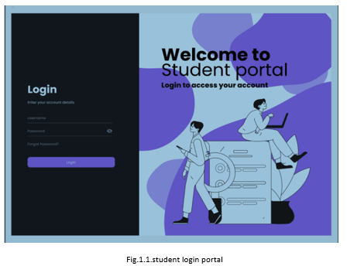

Slide 15
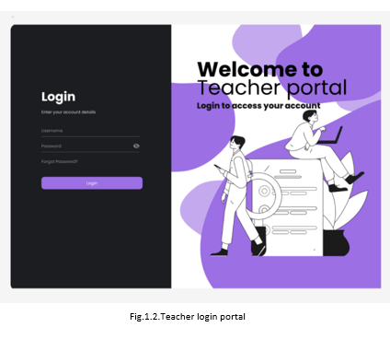

Slide 16
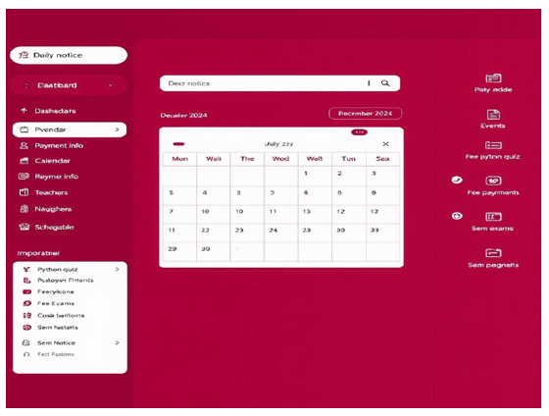
Fig.1.3.Dashboard

Slide 17
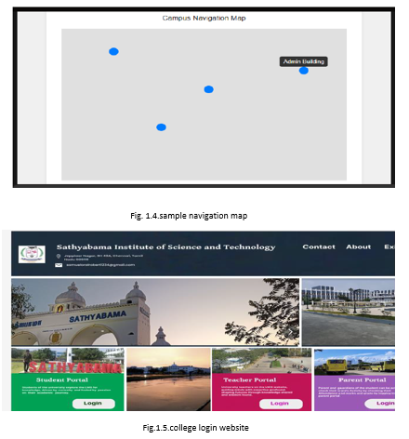

Slide 18
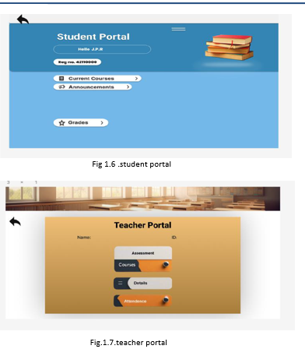

Slide 19
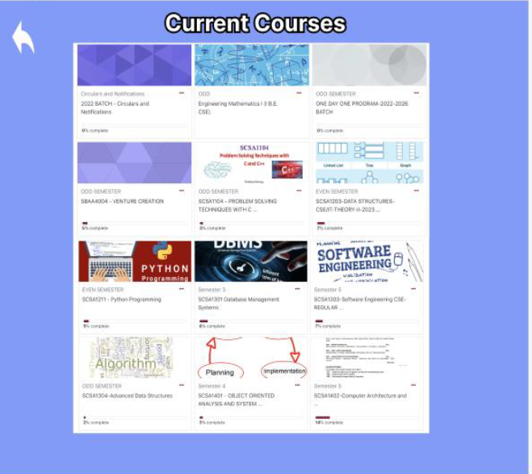
Fig1.8.course access page

Slide 20
Conclusion
In conclusion, the redesign of the university portal significantly enhances the user experience by addressing previously identified pain points and incorporating user--centered design principles.
By streamlining navigation, improving accessibility, and prioritizing key features, the new portal meets the diverse needs of students and faculty alike.
Preliminary feedback suggests increased user satisfaction and engagement, Ongoing user feedback and iterative improvements will ensure the portal remains responsive to user needs

Slide 21
References
[1] | User Experience Design: A Practical Playbook by Gavin Doughtie: This book offers practical approaches to UX design, focusing on techniques and methodologies for creating usercentered experiences.
[2] | Krug, S. (2014). Don’t Make Me Think, Revisited: A Common Sense Approach to Web Usability. New Riders.
[3] | A Comprehensive Guide to User Experience Design by Paul Boag: This resource discusses the essential components of UX design, including strategies for improving web usability and accessibility.
[4] | UX Research: Practical Techniques for Designing Better Products by Brad Nunnally and David Farkas: This book provides a comprehensive guide to UX research methods, helping to inform the redesign process through user insights.

Slide 22

Course Certificate

